Slide 1
Easy Date
a date planning tool by Hannah, Marcus, Damneet, Matt and Alessia
Notes:
Speaker 1

Slide 2
Elevator Pitch
This website is the ultimate simplification of dinner and a movie. Answer a few questions and create the perfect date night
Notes:
Good evening, and welcome to our presentation. I'm Matt of Group 5. today, you will meet our talented team of developers, D, Alessia, Marcus and Hanna.
Here at Group 5, we engineer social problems.
Have you ever wondered why you had to wait for instant coffee?
Have you ever looked out to sea and thought you saw a man, but it was just a buoy? Most significantly, have you had an issue with the heart and didn't know what to do?
Our company's mission is to target the desperate and dateless community and solve their dating woes with a simple application.
This takes the stress away from making some of life's critical decisions we all have experienced in the dating game.
We are based in the Australian love capital of Murray Bridge and have a subsidiary in Belo Horizonte, Brazil and target those singles looking for the perfect date based on
scientific metrics.
If you are looking for love and enticing the perfect life partner, let me introduce you to, Easy Date!
I would like to hand you over to my colleague Marcos, to discuss our user story.

Slide 3
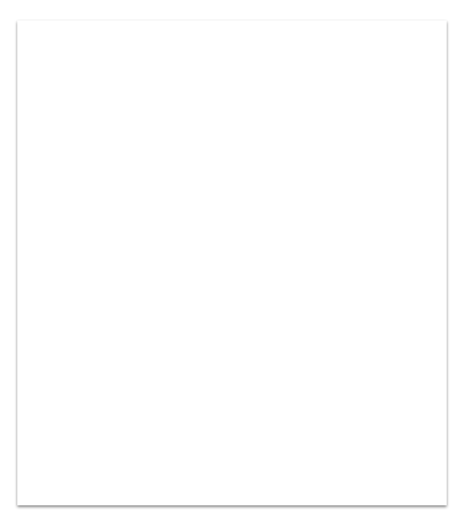
User Story
As a person organising a date I want to use something fun and functional so that I can have a coordinated movie and meal
Quick questions
Mood based results
Like and dislike
Notes:
User story: As a person organising a date I want use something fun and functional so that I can have a coordinated movie and meal
“This project was created mainly to organise a date for our customers quickly and easily, for their day to day.
When a person enters our website, they are presented with a series of questions about their mood, favourite colour, horoscope, etc.
Based on our customers' choices, our website chooses a movie and some type of food that they might enjoy.
A summary and photo are then shown and if the customer likes the combination the like button will save the choice. If the customer dislikes the option the dislike button will rerun the movie query

Slide 4
Process
Wireframes
Pseudo code
Build results HTML + CSS +JS
Presentation
API Investigation
Build index HTML + CSS + JS
Refactor with Tailwind css
Tailwind CSS
Vanilla JS
Toolkit
Google Maps Javascript API
Movie DB API
Planning |  |  |  | Development
Notes:
Process: The coding languages that were used to create this are html css javascript
Major unique factors we used:
CSS framework: Tailwind
APIs: The Movie DB API and Google Maps API
Tasks and roles:
Marcus: original html and css
Damneet: refactored html and css with tailwind
Matt: wireframes in slides, repo setup
Hannah: api and css framework investigation
Alessia: pseudo code
Challenges: Alessia getting not-covid,
Successes: How nice the UI is, properly harnessing the API to give the user a full and simple experience

Slide 5
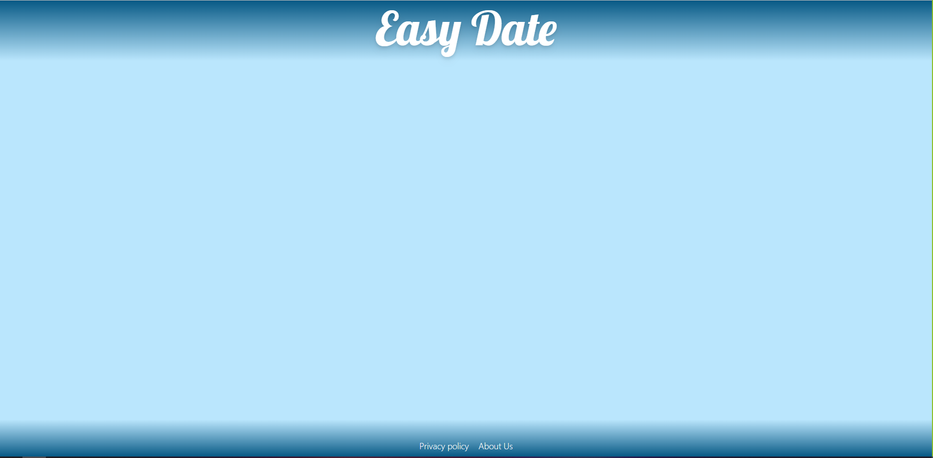
DEMO
Tip
Don’t wait till the end of the presentation to give the bottom line.
Reveal your product or idea (in this case a translation app) up front.

Slide 6
Future Dev
What the ultimate version of Easy Dates looks like:
Add previous dates
More questions to draw from
Remember fixed questions
Adding links to ordering and streaming directly
Notes:
Future development:
Local storage to remember disliked films to not repeat
Adding links to order food and to the streaming service which houses the film
Authenticate site: remember questions that are fixed (star sign)
Randomise movies

Slide 7
Links to Application
Live Page: https://mattdryan.github.io/Easy-Date/
Github Repo: https://github.com/MattDRyan/Easy-Date

